Slide 1


Nikhil Rao
5th October 2022

Slide 2

Outline
Executive Summary
Introduction
Methodology
Results
Conclusion
Appendix

Slide 3
Executive Summary
Summary of methodologies
Data Collection via API, Web Scraping • Exploratory Data Analysis (EDA) with Data Visualization • EDA with SQL • Interactive Map with Folium • Dashboards with Plotly Dash • Predictive Analysis
Summary of all results
Exploratory Data Analysis results • Interactive maps and dashboard • Predictive results

Slide 4
Introduction
Project background and context
The aim of this project is to predict if the Falcon 9 first stage will successfully land. SpaceX says on its website that the Falcon 9 rocket launch cost 62 million dollars. Other providers cost upward of 165 million dollars each. The price difference is explained by the fact that SpaceX can reuse the first stage. By determining if the stage will land, we can determine the cost of a launch. This information is interesting for another company if it wants to compete with SpaceX for a rocket launch.
Problems you want to find answers
What are the main characteristics of a successful or failed landing ? • What are the effects of each relationship of the rocket variables on the success or failure of a landing ? • What are the conditions which will allow SpaceX to achieve the best landing success rate ?

Slide 5

Section 1

Slide 6
Methodology
Executive Summary
Data collection methodology:
SpaceX REST API • Web Scraping (Source: Wikipedia)
Perform data wrangling
Dropping unnecessary columns • One Hot Encoding for classification models
Perform exploratory data analysis (EDA) using visualization and SQL
Perform interactive visual analytics using Folium and Plotly Dash
Perform predictive analysis using classification models
How to build, tune, evaluate classification models

Slide 7
Data Collection
Describe how data sets were collected.
The information obtained by the API are rocket, launches, payload information. The information obtained by the webscraping Wikipedia URLs are launches, landing, payload information.
SpaceX Rest API Call
API returns JSON file
Make dataframe from JSON
Clean data and export hai

Slide 8
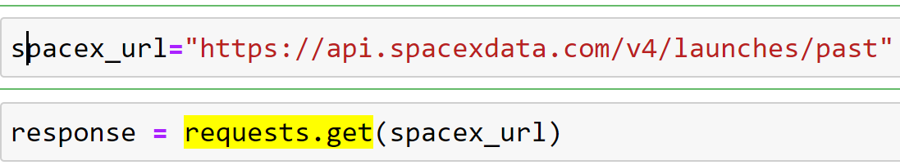
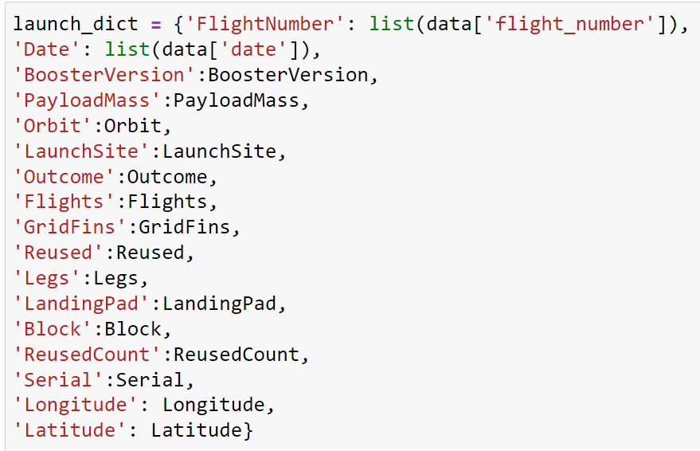
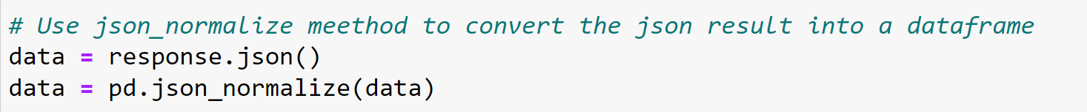
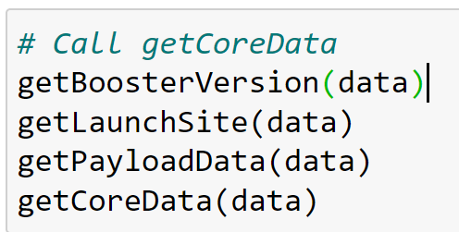
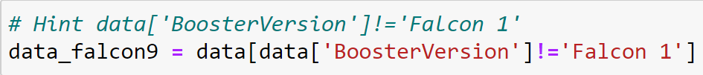
Data Collection – SpaceX API
Getting Response from API
Convert Response to JSON File
Transform data
Create dictionary with data
. Create and filter dataframe and export to file

Slide 9
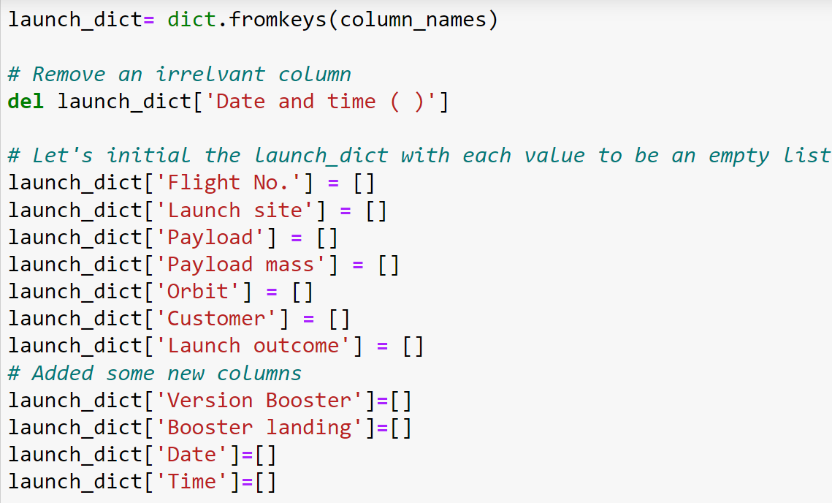
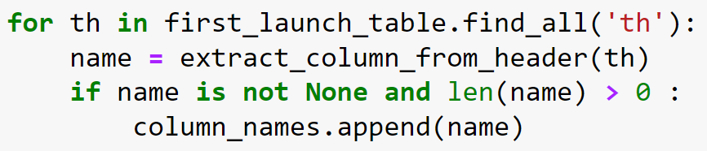
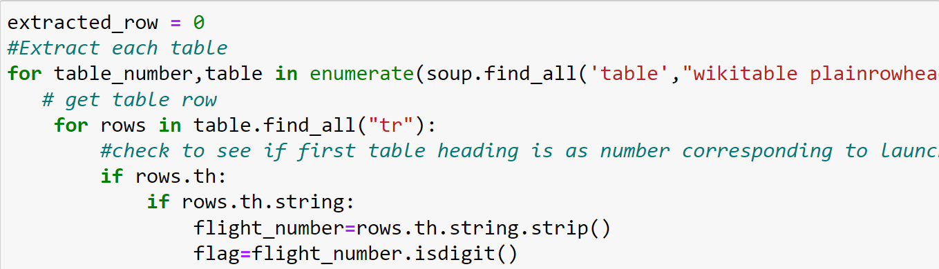
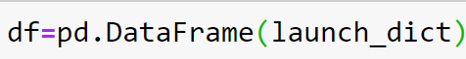
Data Collection - Scraping
Getting Response from HTML
Create BeautifulSoup Object
Find all tables
Get column names
Create dataframe from dictionary
Creating dictionary
Add data to keys, export to file

Slide 10
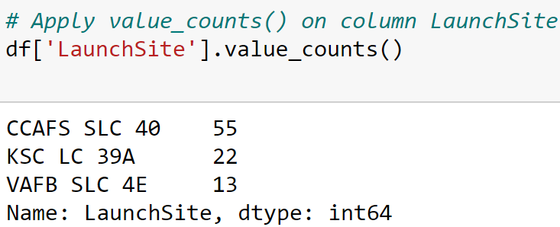
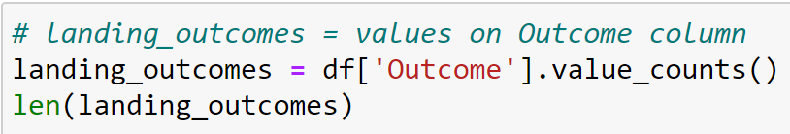
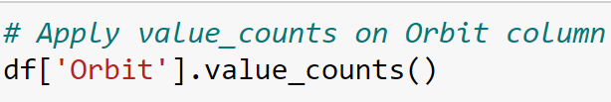
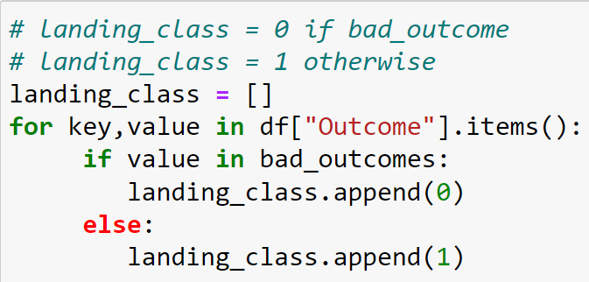
Data Wrangling
In the dataset, there are several cases where the booster did not land successfully. True Ocean, True RTLS, True ASDS means the mission has been successful. False Ocean, False RTLS, False ASDS means the mission was a failure. We need to transform string variables into categorical variables where 1 means the mission has been successful and 0 means the mission was a failure.
Calculate launches number for each site . Calculate number and occurrence of mission outcome per orbit
Calculate the number and occurence of each orbit Create landing outcome label from Outcome column, export file

Slide 11
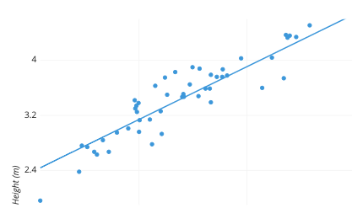
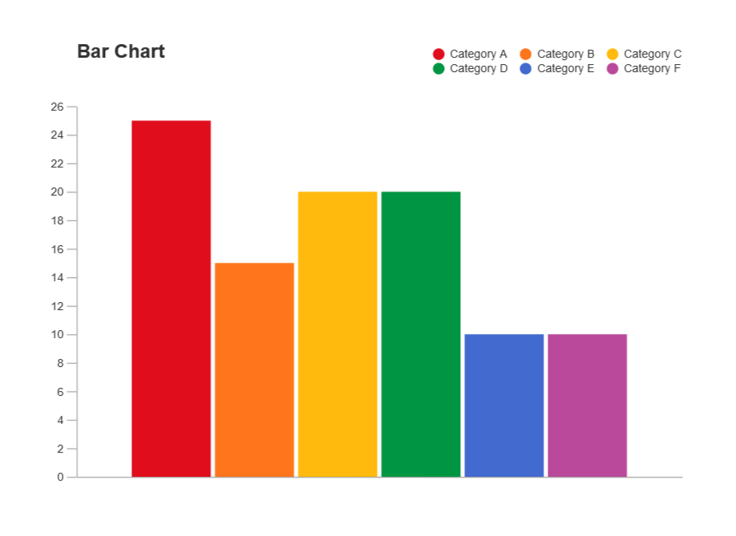
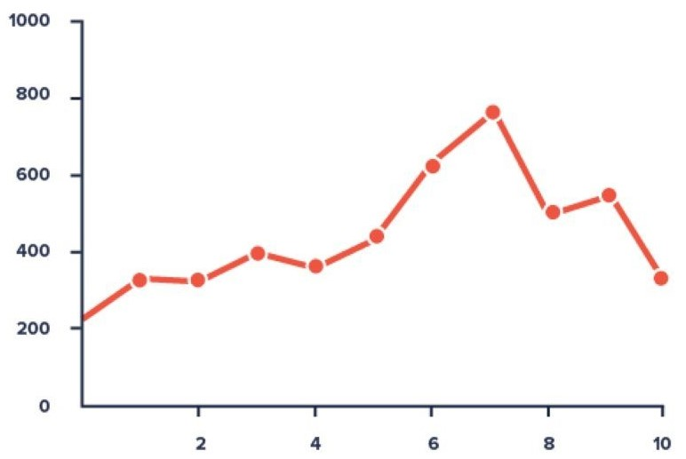
EDA with Data Visualization
Scatter Graphs:= Flight Number vs. Payload Mass, Flight Number vs. Launch Site, Payload vs. Launch Site, Orbit vs. Flight Number, Payload vs. Orbit Type, Orbit vs. Payload Mass
Scatter plots show correlation between variables.
Bar Graph • Success rate vs. Orbit Line Graph • Success rate vs. Year
Bar graphs show the relationship between Line graphs show data variables and their trends.
numeric and categorical variables and show global behavior and make prediction

Slide 12
EDA with SQL
We performed SQL queries to gather and understand data from dataset: Displaying the names of the unique launch sites in the space mission. Display 5 records where launch sites begin with the string 'CCA' Display the total payload mass carried by boosters launched by NASA (CRS). Display average payload mass carried by booster version F9 v1.1. List the date when the first successful landing outcome in ground pad was achieved. List the names of the boosters which have success in drone ship and have payload mass greater than 4000 but less than 6000. List the total number of successful and failure mission outcomes. List the names of the booster_versions which have carried the maximum payload mass. List the records which will display the month names, failure landing_outcomes in drone ship, booster versions, launch_site for the months in year 2015. Rank the count of successful landing outcomes between the date 04-06-2010 and 20-03-2017 in descending order.

Slide 13
Build an Interactive Map with Folium
Folium map object is a map centered on NASA Johnson Space Center at Houson, Texas Red circle at NASA Johnson Space Center's coordinate with label showing its name (folium.Circle, folium.map.Marker). Red circles at each launch site coordinates with label showing launch site name (folium.Circle, folium.map.Marker, folium.features.DivIcon). The grouping of points in a cluster to display multiple and different information for the same coordinates (folium.plugins.MarkerCluster). Markers to show successful and unsuccessful landings. Green for successful landing and Red for unsuccessful landing. (folium.map.Marker, folium.Icon). Markers to show distance between launch site to key locations (railway, highway, coastway, city) and plot a line between them. (folium.map.Marker, folium.PolyLine, folium.features.DivIcon). These objects are created in order to understand better the problem and the data. We can show easily all launch sites, their surroundings and the number of successful and unsuccessful landings.

Slide 14
Build a Dashboard with Plotly Dash
Dashboard has dropdown, pie chart, rangeslider and scatter plot components • Dropdown allows a user to choose the launch site or all launch sites (dash_core_components.Dropdown). • Pie chart shows the total success and the total failure for the launch site chosen with the dropdown component (plotly.express.pie). • Rangeslider allows a user to select a payload mass in a fixed range (dash_core_components.RangeSlider). • Scatter chart shows the relationship between two variables, in particular Success vs Payload Mass (plotly.express.scatter)

Slide 15
Predictive Analysis (Classification)
Data preparation • Load dataset • Normalize data • Split data into training and test sets. • Model preparation • Selection of machine learning algorithms • Set parameters for each algorithm to GridSearchCV • Training GridSearchModel models with training dataset • Model evaluation • Get best hyperparameters for each type of model • Compute accuracy for each model with test dataset • Plot Confusion Matrix • Model comparison • Comparison of models according to their accuracy • The model with the best accuracy will be chosen (see Notebook for result)

Slide 16
Results
Exploratory data analysis results
Interactive analytics demo in screenshots
Predictive analysis results

Slide 17

Section 2

Slide 18
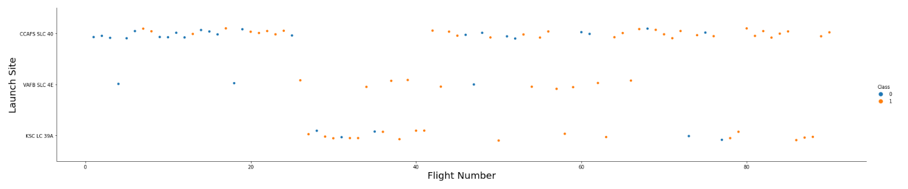
Flight Number vs. Launch Site
Show a scatter plot of Flight Number vs. Launch Site
Show the screenshot of the scatter plot with explanations

Slide 19
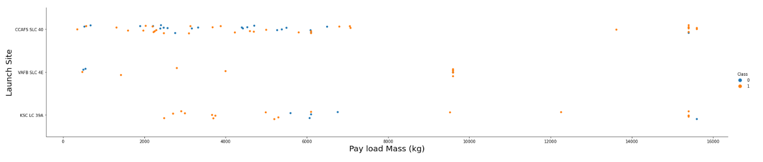
Payload vs. Launch Site
Show a scatter plot of Payload vs. Launch Site
Show the screenshot of the scatter plot with explanations

Slide 20
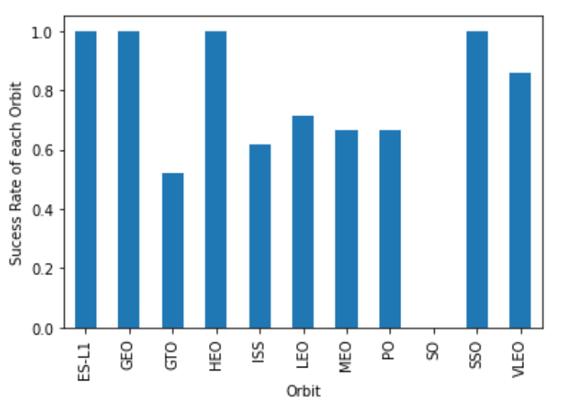
Success Rate vs. Orbit Type
Show a bar chart for the success rate of each orbit type
Show the screenshot of the scatter plot with explanations

Slide 21
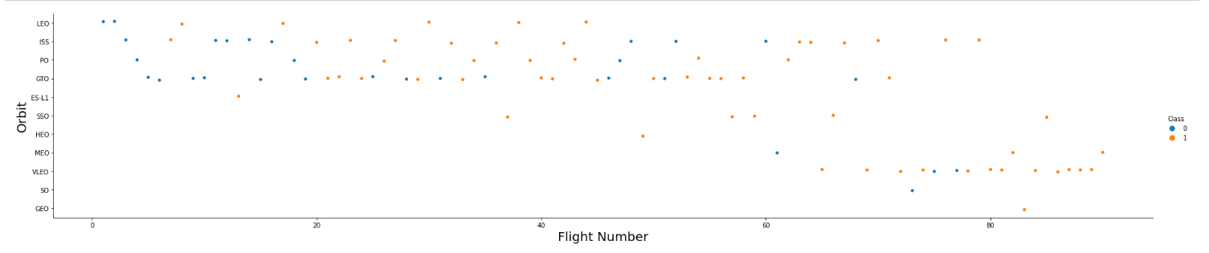
Flight Number vs. Orbit Type
Show a scatter point of Flight number vs. Orbit type
Show the screenshot of the scatter plot with explanations

Slide 22
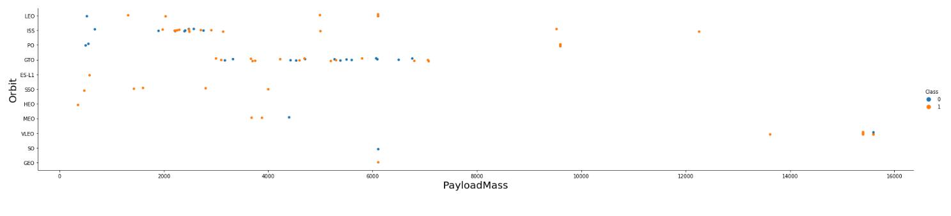
Payload vs. Orbit Type
Show a scatter point of payload vs. orbit type
Show the screenshot of the scatter plot with explanations

Slide 23
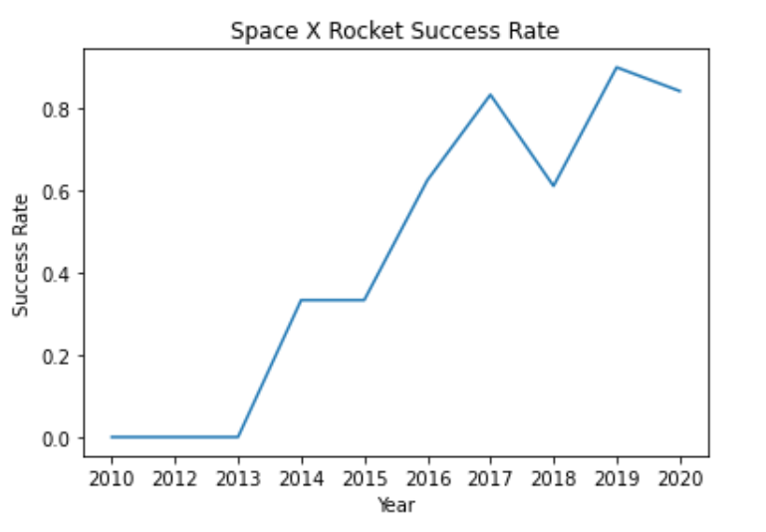
Launch Success Yearly Trend
Show a line chart of yearly average success rate
Show the screenshot of the scatter plot with explanations

Slide 24
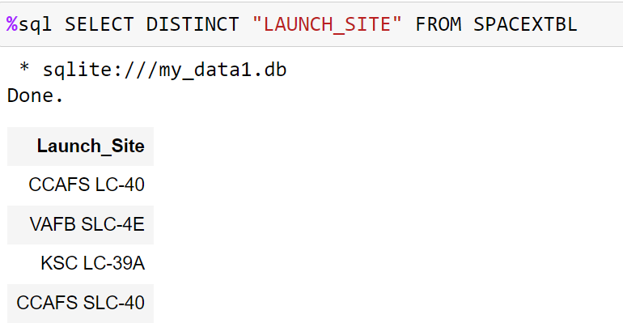
All Launch Site Names
Find the names of the unique launch sites
Explanation The use of DISTINCT in the query allows to remove duplicate LAUNCH_SITE.

Slide 25
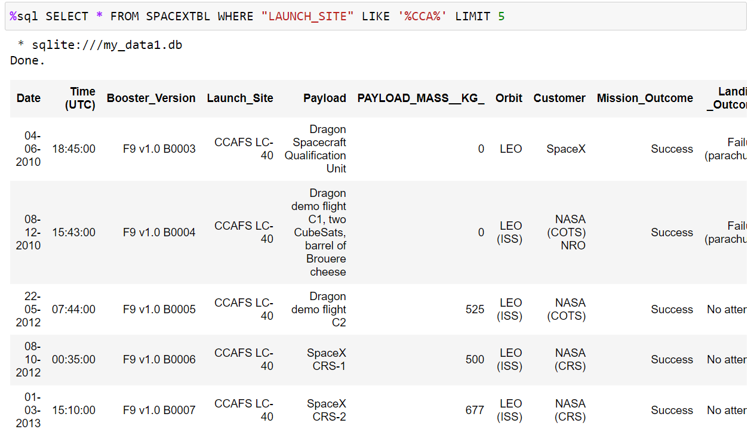
Launch Site Names Begin with 'CCA'
Find 5 records where launch sites begin with `CCA`
The WHERE clause followed by LIKE clause filters launch sites that contain the substring CCA. LIMIT 5 shows 5 records from filtering.

Slide 26
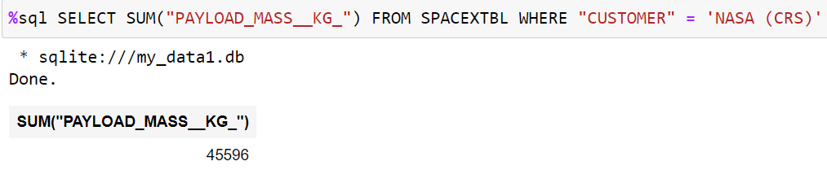
Total Payload Mass
Calculate the total payload carried by boosters from NASA
This query returns the sum of all payload masses where the customer is NASA (CRS)

Slide 27
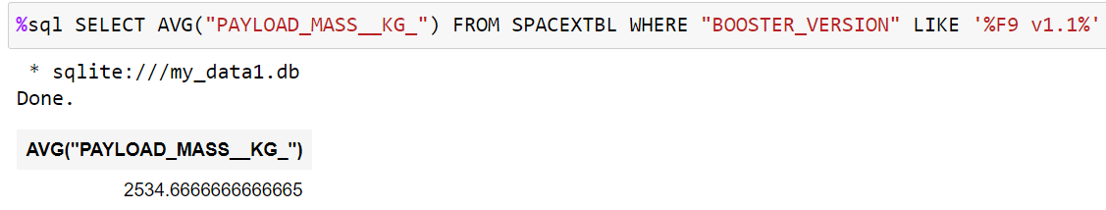
Average Payload Mass by F9 v1.1
Calculate the average payload mass carried by booster version F9 v1.1
This query returns the average of all payload masses where the booster version contains the substring F9 v1.1

Slide 28
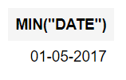
First Successful Ground Landing Date
Find the dates of the first successful landing outcome on ground pad
With this query, we select the oldest successful landing. The WHERE clause filters dataset in order to keep only records where landing was successful. With the MIN function, we select the record with the oldest date.

Slide 29
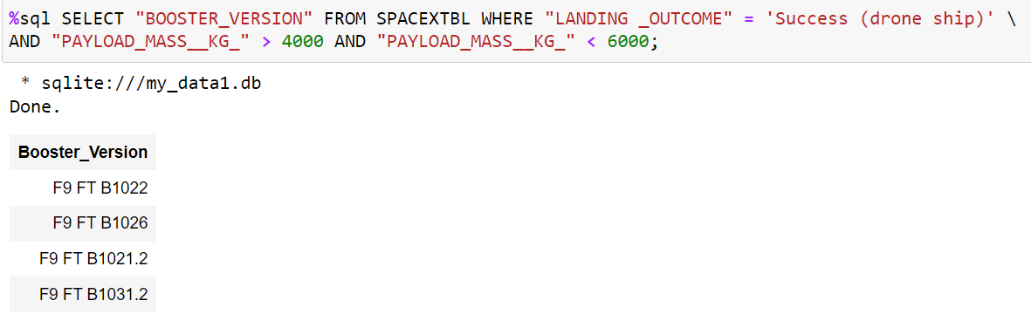
Successful Drone Ship Landing with Payload between 4000 and 6000
List the names of boosters which have successfully landed on drone ship and had payload mass greater than 4000 but less than 6000
This query returns the booster version where landing was successful and payload mass is between 4000 and 6000 kg. The WHERE and AND clauses filter the dataset.

Slide 30
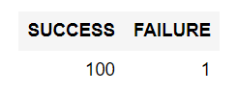
Total Number of Successful and Failure Mission Outcomes
Calculate the total number of successful and failure mission outcomes
With the first SELECT, we show the subqueries that return results. The first subquery counts the successful mission. The second subquery counts the unsuccessful mission. The WHERE clause followed by LIKE clause filters mission outcome. The COUNT function counts records filtered.

Slide 31
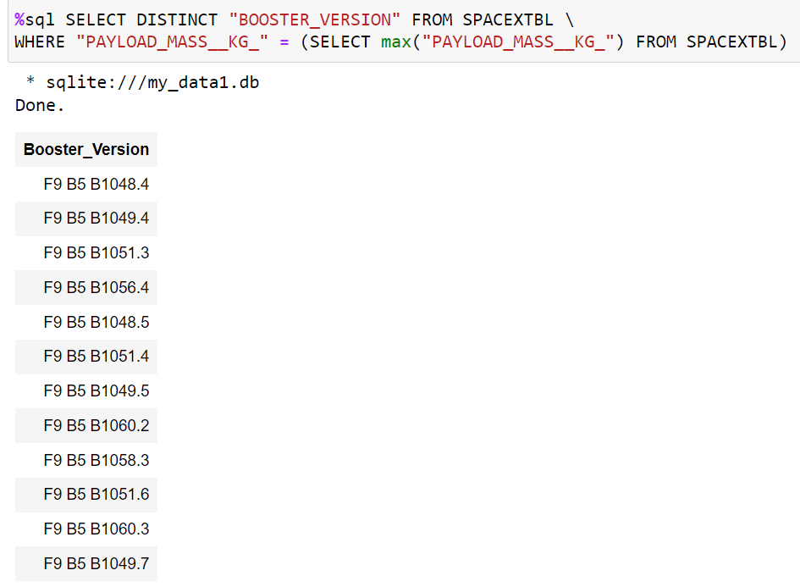
Boosters Carried Maximum Payload
List the names of the booster which have carried the maximum payload mass
We used a subquery to filter data by returning only the heaviest payload mass with MAX function. The main query uses subquery results and returns unique booster version (SELECT DISTINCT) with the heaviest payload mass.

Slide 32
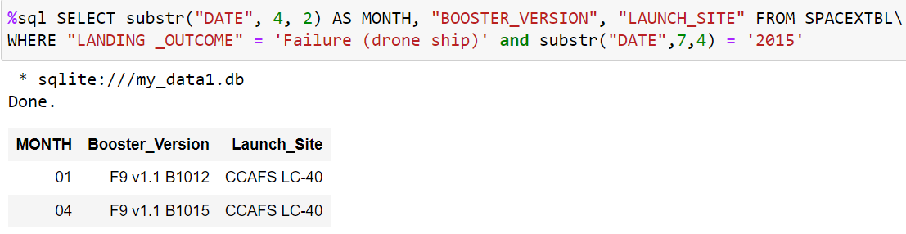
2015 Launch Records
List the failed landing_outcomes in drone ship, their booster versions, and launch site names for in year 2015.
This query returns month, booster version, launch site where landing was unsuccessful and landing date took place in 2015. Substr function process date in order to take month or year. Substr(DATE, 4, 2) shows month. Substr(DATE,7, 4) shows year.

Slide 33
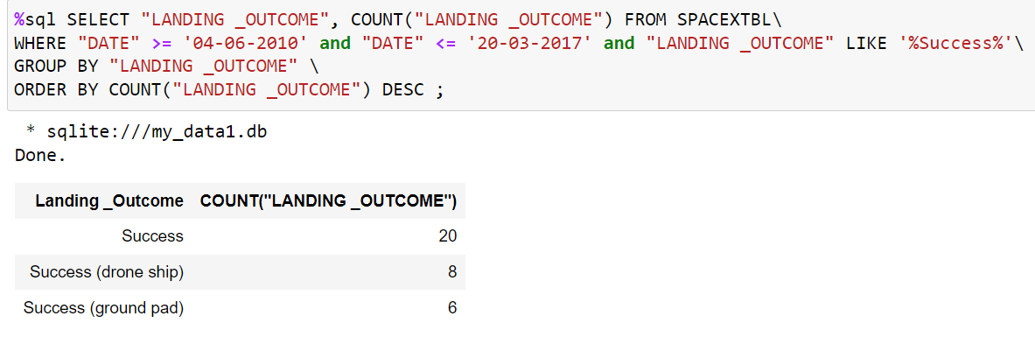
Rank Landing Outcomes Between 2010-06-04 and 2017-03-20
Rank the count of landing outcomes (such as Failure (drone ship) or Success (ground pad)) between the date 2010-06-04 and 2017-03-20, in descending order
This query returns landing outcomes and their count where mission was successful and date is between 04/06/2010 and 20/03/2017. The GROUP BY clause groups results by landing outcome and ORDER BY COUNT DESC shows results in decreasing order.

Slide 34

Section 3

Slide 35
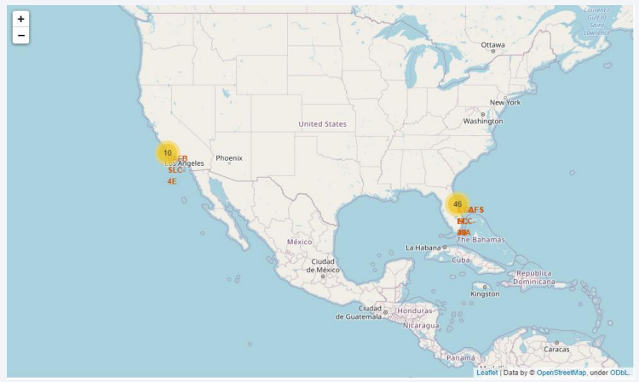
Folium map – Ground stations
We see that SpaceX launch sites are located on the coast of the United States

Slide 36
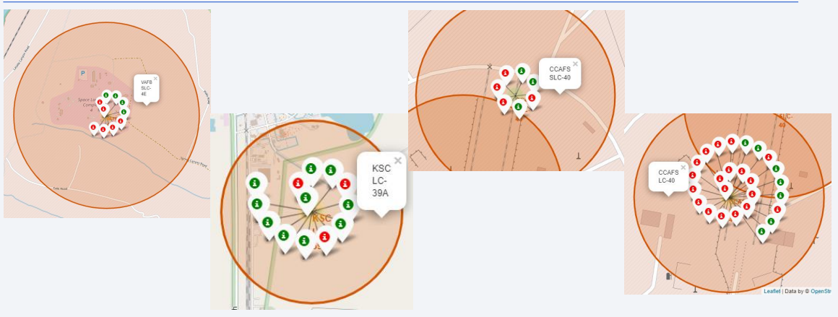
Folium Map 2 - Color Labeled Markers
Green marker represents successful launches. Red marker represents unsuccessful launches. We note that KSC LC-39A has a higher launch success rate.

Slide 37
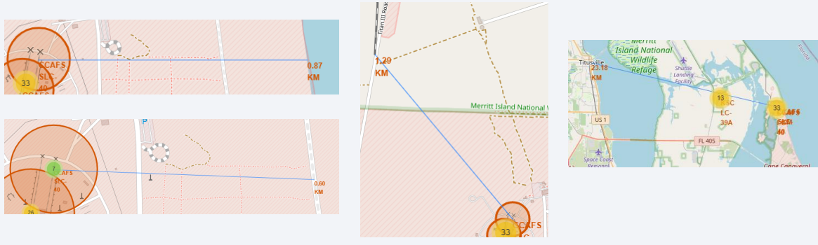
Folium Map 3 - Distances between CCAFS SLC-40 and its proximities
Is CCAFS SLC-40 in close proximity to railways ? Yes
Is CCAFS SLC-40 in close proximity to highways ? Yes
Is CCAFS SLC-40 in close proximity to coastline ? Yes
Do CCAFS SLC-40 keeps certain distance away from cities ? No

Slide 38

Section 4

Slide 39
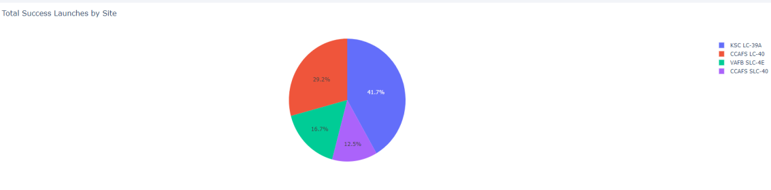
Dashboard - Total success by Site
We see that KSC LC-39A has the best success rate of launches.

Slide 40
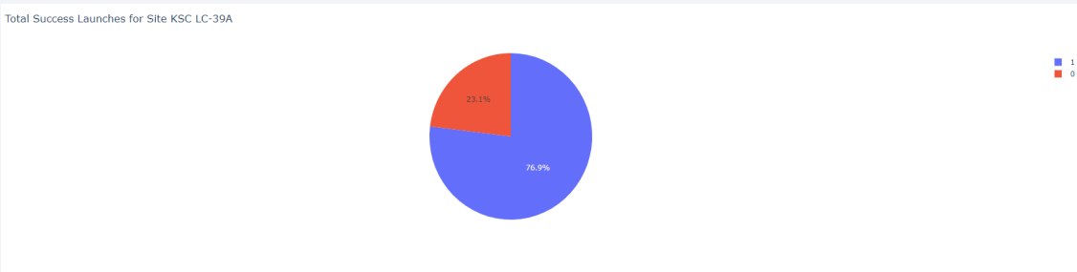
Dashboard 2 - Total success launches for Site KSC LC-39A
We see that KSC LC-39A has achieved a 76.9% success rate while getting a 23.1% failure rate.

Slide 41
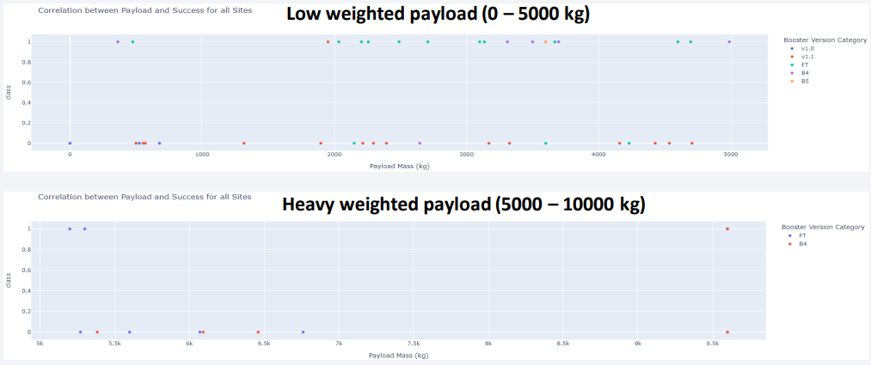
Dashboard 3 - Payload mass vs Outcome for all sites with different payload mass selected
Low weighted payloads have a better success rate than the heavy weighted payloads.

Slide 42

Section 5

Slide 43
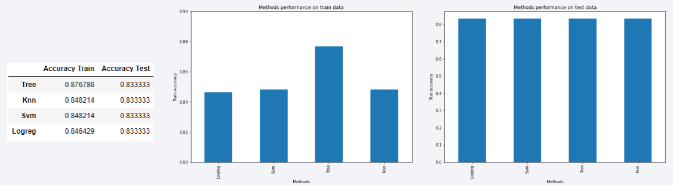
Classification Accuracy
For accuracy test, all methods performed similar. We could get more test data to decide between them. But if we really need to choose one right now, we would take the decision tree.

Slide 44
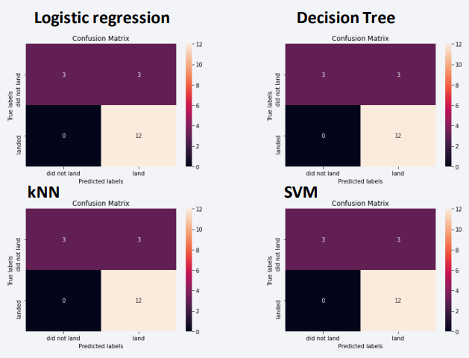
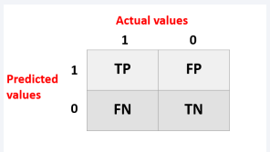
Confusion Matrix
As the test accuracy are all equal, the confusion matrices are also identical. The main problem of these models are false positives.

Slide 45
Conclusions
The success of a mission can be explained by several factors such as the launch site, the orbit and especially the number of previous launches. Indeed, we can assume that there has been a gain in knowledge between launches that allowed to go from a launch failure to a success.
• The orbits with the best success rates are GEO, HEO, SSO, ES-L1.
• Depending on the orbits, the payload mass can be a criterion to take into account for the success of a mission. Some orbits require a light or heavy payload mass. But generally low weighted payloads perform better than the heavy weighted payloads.
• With the current data, we cannot explain why some launch sites are better than others (KSC LC-39A is the best launch site). To get an answer to this problem, we could obtain atmospheric or other relevant data.
• For this dataset, we choose the Decision Tree Algorithm as the best model even if the test accuracy between all the models used is identical. We choose Decision Tree Algorithm because it has a better train accuracy.

Slide 46


